Slide 1

Introduction of Islamic Banking
and Finance
Muhammad Zubair Mughal
Managing Director
AllHuda Centre of Islamic Banking and Economics
www.alhudacibe.com

Slide 2
Contents
Why Islamic Finance ?
Sources of Islamic Banking and Finance.
Total Size of Islamic Finance
Regional Developments
Opportunities
Challenges
www.alhudacibe.com

Slide 3
Why Islamic Banking and Finance necessary?
Prohibition of Interest
Financial Inclusion.
Asset Based Financing & Sustainable Financial System.
Higher impact than Conventional Financial System.
Islamic finance is a sub-set of Islamic Economic system
Social well Being and Financial Inclusion
Use of Fintech
Fulfillment of Sustainable Development Goals
Solution for all.
“Assisting the poor is a pillar of Islam”

Slide 4
Islam and Islamic Finance
Islam
Aqidah
(Faith & Belief)
Shariah
(Practices & Activities)
IBADAT
(Man to God Worship)
Muamalat
(Man to Man Activities)
Political Activities
Economic Activities
Banking & Financial Activities
Social Activities
Akhlaq
(Morality & Ethics)
www.alhudacibe.com
Notes:
Source: Institute of Policy Studies

Slide 5
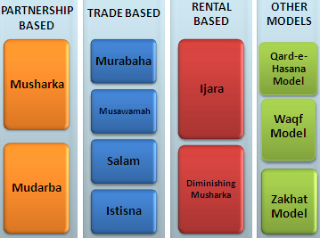
Sources & Utilization of Islamic Finance Products
Sources of Islamic Finance Products
Islamic Finance Product Mechanism
Quran
Sunnah
Ijma’a (jurist consensus)
Ijtihad & Qiyas (analogy)
www.alhudacibe.com

Slide 6
Difference between Islamic and Conventional Banking
Money
Conventional
Bank
Client
Money + Money(interest)
Islamic Banking
Goods & Services
Bank
Client
Money
www.alhudacibe.com

Slide 7
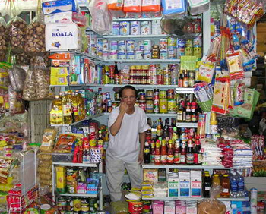
Islamic Finance Products
Murabahah – Cost Plus Sale
Literally it means a sale on mutually agreed profit, also known as cost plus sales, it is one of the most widely used instruments for short-term financing where the Bank/MFI undertakes to supply specific goods or commodities at mutually agreed profit to the client.
Utilization :
Murabahah can be utilize for Purchase of raw materials, equipment, Machinery, Consumer goods, Vehicle, Houses etc..
Currently Practiced:
AL Baraka Bank, Meezan, Intl Bank of Azerbaijan,
Islamic Bank, Islamic Bank Bangladesh
www.alhudacibe.com

Slide 8

Products in Islamic Finance
Ijara – Islamic Lease
Ijarah Means Operating lease. It is an arrangement under which the Islamic Bank/MFI lease equipments, light Vehicles, Instruments, buildings or other facilities to a client, against an agreed rental.
Utilization :
Auto Financing, Equipment Financing, House
Lease, small production unit lease etc.
Currently Practiced:
Ansar Leasing, Al-Amal Microfinance Bank, NRDP, CWCD etc.
Amanah Islamic Bank – Philippines.
www.alhudacibe.com

Slide 9

Islamic Finance Products
Salam – Forward Sale
Salam means a contract in which advance payment is made for goods to be delivered later on. The seller undertakes to supply some specific goods to the buyer at a future date in exchange of an advance price fully paid at the time of contract
Utilization in Halal Industry:
Salam is ideal product for Agricultural Financing, it can also utilize for other business purposes as well.
Currently Practiced:
Meezan Bank, Albaraka Bank etc
www.alhudacibe.com

Slide 10
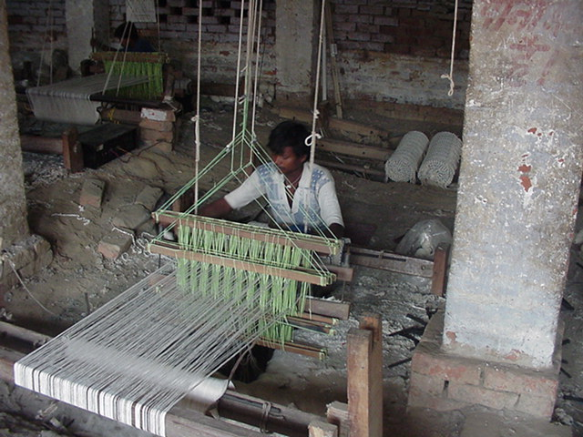
Islamic Finance Products
Istisna - Manufacturing contract
A pre-delivery financing instrument used to finance projects where commodity is transacted before it comes into existence. It is an order to manufacture and payment of price, unlike Salam, it’s flexible, where price may be paid in advance, or in installments or on delivery of good.
Utilization:
Istisna May Utilize for small manufacturing Business, for production use, Micro entrepreneur Development sectors etc.
Currently Practiced:
Meezan bank, Ghana Islamic Microfinance bank,
DIB, Maybank, Standard Chartered etc.
www.alhudacibe.com

Slide 11

Islamic Finance Products
Musharaka - Partnership
Musharakah means a relationship established under a contract by the mutual consent of the parties for sharing of profits and losses in the joint business.
Utilization :
Musharakah can be used for venture capital, Business setup’s, productive projects, Working capital financing, Housing Projects etc.
Currently Practiced:
CIMB, Amanah Islamic bank, AL Baraka, DIB,
etc
www.alhudacibe.com

Slide 12
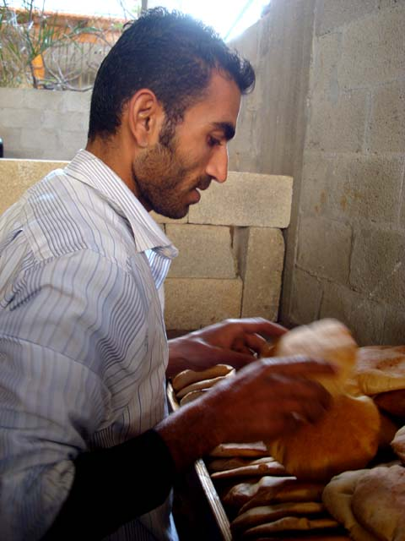
Islamic Finance Products
Mudaraba - Partnership
A trustee-type finance contract under which one party (MFI) provides the capital for a project and the other party ( Client) provides the labor/Skill. Profit sharing is agreed between the two parties on mutual consent but the losses should be borne by the provider of funds .
Utilization:
Business, Microenterprise setup’s, As Deposit Mobilization product,
Working capital financing etc.
Currently Practiced :
Bank of Khyber, Islamic Bank Bangladesh, CWCD,
Islamic Relief, Awqaf South Africa etc.
www.alhudacibe.com

Slide 13

Islamic Finance Products
Diminishing Musharkah
Diminishing Musharkah is a form of Musharakah where the MFI and his client participate in a joint commercial enterprise or property. This attains the form of undivided ownership of both the financier and the client. Over certain period the equity of financier is purchased by the client
Utilization:
This is an ideal product for Housing Finance sector, but also utilize for other ventures as well.
Currently Practiced:
HSBC, DIB, Albaraka etc.
www.alhudacibe.com

Slide 14

Islamic Finance Products - Charity
Other Products
Qard-e-Hassana Model, Waqf Model, Zakat Model, Cooperative Model, BMTs, Micro Takaful ( Islamic Micro insurance )
Utilization :
Qard-e-Hassana : for Emergency Loan, benevolence loan, Student, Maternity etc
Zakat : Health, Shelter, Safety net programs, Education and where Zakat applicable. MicroTakaful: Micro Risk Management, Crop & Livestock Insurance etc.
Currently Practiced
AIMS- Malaysia, Akhuwat, Awqaf South Africa ,
Al-Amal Microfinance bank, BMTs - Indonesia etc
www.alhudacibe.com

Slide 15
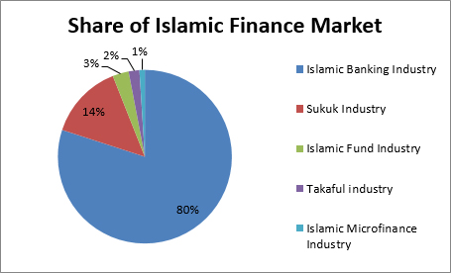
Global Size of Islamic Finance
orldwide is now estimated at:
Total Islamic Finance Industry Size: USD 2.6+ Trillion
2500 + Islamic Financial Institutions in 102 Countries
600 + Islamic Banking and Finance Education and Training Institutions.
By the end of 2020, the total volume of Islamic Finance Industry is expected to be USD 2.8 trillion.
www.alhudacibe.com

Slide 16
Islamic Banking Industry
Share of Islamic Banking in Islamic Finance: 80%
Total Size USD 1.85 Trillion
In 100+ Countries.
Major Markets: Malaysia, KSA, UAE, Qatar, Pakistan, Iran, Indonesia etc.
Future Markets: Central Asia, East & West Africa, Eastern Europe, India, Russia etc
www.alhudacibe.com

Slide 17
Takaful Industry
Share of Takaful industry in Islamic Finance: 2%
Total Size USD 30+ Billion
300+ Takaful Companies/Operators in 57 countries.
25 Re-Takaful companies
Major Markets: Malaysia, UAE, Qatar, Indonesia, Pakistan, KSA.
Future Markets: Turkey, Nigeria, Tunisia, Central Asia, Egypt.
www.alhudacibe.com

Slide 18
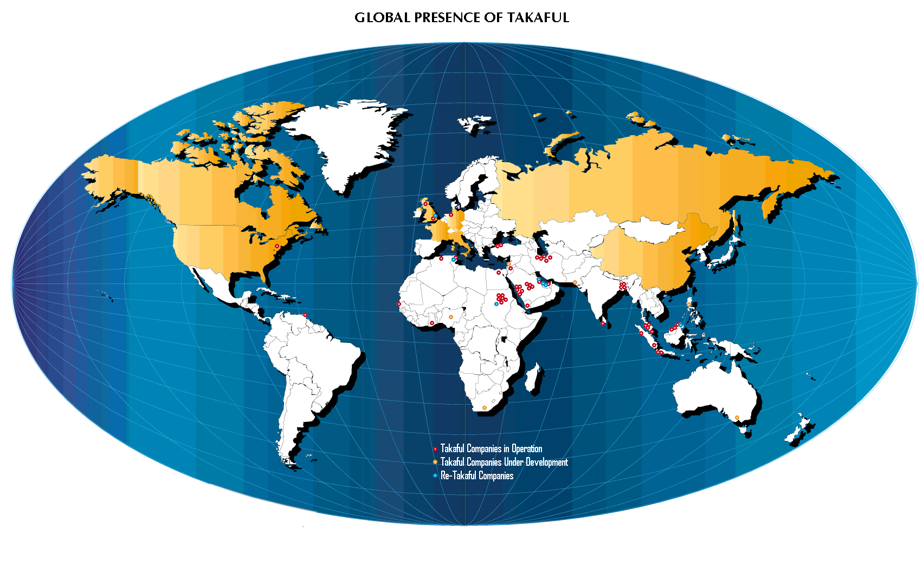
www.alhudacibe.com

Slide 19

Sukuk Industry
The number of Takaful operators worldwide is now estimated at:
Share of Sukuk industry in Islamic Finance: 14%
Total outstanding Sukuk Volume: USD 350 Billion
Total Number of out standing Sukuk: 1500+
Volume of Expected Sukuk in 2017: USD 78 Billion.
Major Markets: UAE, Qatar, Bahrain, Malaysia, Indonesia.
Future Markets: West Africa, Nigeria, Central Asia.
www.alhudacibe.com

Slide 20
Islamic Microfinance
The number of Takaful operators worldwide is now estimated at:
Share of Islamic Microfinance in Islamic Finance: 1%
Total Size USD 1.5 Billion
500+ Islamic Microfinance Banks/Institutions
In 46 Countries.
Major Markets: Pakistan, Afghanistan, Yemen, Sudan, Nigeria, Iraq etc.
Future Markets: Jordan, Palestine, India, Albania, Turkey, Senegal, Togo, Tanzania etc.
www.alhudacibe.com

Slide 21
Islamic Microfinance Institution Worldwide
Germany:2
- Muslim Society
Switzerland: 2
UAE: 4
- Dubai Islamic Bank
- Abu Dhabi Islamic Bank
- HSBC Amanah
UK: 5
- HSBC Amanah
- Muslim Aid
- Islamic Relief
Faith Matters
- The Halal Mutual Investment Company
Kuwait: 2
- Kuwait Finance House
United States: 3
Helping Hands
ISNA
Lariba
Bahrain: 2
Family Bank
Afghanistan 9:
- FINCA , WOCCU
- CHF
Ariana
Iran: 8
Pakistan: 21
India: 3
Bangladesh:9
Turkey: 2
- Faisal Finance Institution
- Ikhlas Finance House
Egypt: 3
- Alwatany Bank of Egypt
- Egyptian Saudi Finance
Malaysia: 11
2 - Pure Islamic Banks (Bank Islam, Bank Muamalat)
Rest - banks
Sudan: 13
Yemen: 05
Al- Amal
Al Kuraimi
South Africa
Awqaf SA
Muaritius
AlBaraka MPCS
Indonesia: 133
BPRS , BMT.
IMFI’s Worldwide: 500 *
Market Size: 1.5 billion USD

Slide 22
Islamic Finance Education & Training Providers
The number of Takaful operators worldwide is now estimated at:
Number of Education and Training Providers: 600+
150+ Universities have Islamic Banking and Finance Programs
Only Pakistan have 18 Universities
400+ Training Providers
In 50+ Countries.
Major Market: Malaysia, UK, Pakistan, Nigeria, Indonesia, Tunisia
Future Markets: Kenya, West Africa, Turkey.
www.alhudacibe.com

Slide 23







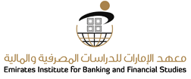









Universities Offering Islamic Banking & Finance Programs Worldwide
Salford University, UK | Durham University, UK | Aston Business School, UK
La Trobe University, Australia | Effat University, Saudi Arabia | University College of Bahrain, Kingdom of Bahrain
University Tun Abdul Razak, Malaysia, | Emirates Institute for Banking & Financial Studies (EIBFS), UAE | The University of Bedfordshire, UK
Kulliyyah of Economics & Management Sciences, Malaysia | University of Aberdeen UK | Institute of Islamic Banking and Finance, India
International Institute of Islamic Banking & Finance (IIIBF), Nigeria | The Marlfield Institute of Higher Education, UK | Al Jamia Al Islamiyah, India
INCEIF, The Global University of Islamic Finance, Malaysia | Qatar Faculty of Islamic Studies, Qatar | EUCLID, USA
www.alhudacibe.com

Slide 24















Universities Offering Islamic Banking & Finance Programs Worldwide
Universities Offering Islamic Banking & Finance Programs Worldwide
London School of Business and Finance, UK | Bangor Business School at Bangor University UK | University of Reading UK
University Of Wales , Malaysia | The University of East London UK | University of Aberdeen, UK
Paris-Dauphine University, Paris | Al-Madinah Int’l University; Malaysia | University of Management and Technology Pakistan
Institute of Management Sciences, Pakistan | University of Central Punjab, Pakistan | International Islamic University, Pakistan
Ripah International University, Pakistan | Minhaj University Pakistan | COMSAT Institute of Information Technology, Pakistan
London School of Business and Finance, UK | Bangor Business School at Bangor University UK | University of Reading UK
University Of Wales , Malaysia | The University of East London UK | University of Aberdeen, UK
Paris-Dauphine University, Paris | Al-Madinah Int’l University; Malaysia | University of Management and Technology Pakistan
Institute of Management Sciences, Pakistan | University of Central Punjab, Pakistan | International Islamic University, Pakistan
Ripah International University, Pakistan | Minhaj University Pakistan | COMSAT Institute of Information Technology, Pakistan
www.alhudacibe.com

Slide 25














Institutes Providing Training in Islamic Banking & Finance Worldwide
Institutes Providing Training in Islamic Banking & Finance Worldwide
Institute of Islamic Banking and Finance, India | AlHuda Centre of Islamic Banking & Eco | Islamic Banking And Finance Centre UK
Ethica Institute of Islamic Finance UAE | Academy for International Modern Studies (AIMS), UK | Islamic Research and Training Institute (IRTI) Saudi Arabia
Institute of Islamic Banking and Insurance, UK | Australian Centre for Islamic Finance, Australia | National Institute of Banking And Finance(NIBAF), Pakistan
The Institute of Bankers Pakistan | Centre for Islamic Economics, Pakistan | International Institute of Islamic Finance, INC. Malaysia
INCEIF, The Global University of Islamic Finance, Malaysia | Guidance Institute | BIBF, Kingdom of Bahrain
Institute of Islamic Banking and Finance, India | AlHuda Centre of Islamic Banking & Eco | Islamic Banking And Finance Centre UK
Ethica Institute of Islamic Finance UAE | Academy for International Modern Studies (AIMS), UK | Islamic Research and Training Institute (IRTI) Saudi Arabia
Institute of Islamic Banking and Insurance, UK | Australian Centre for Islamic Finance, Australia | National Institute of Banking And Finance(NIBAF), Pakistan
The Institute of Bankers Pakistan | Centre for Islamic Economics, Pakistan | International Institute of Islamic Finance, INC. Malaysia
INCEIF, The Global University of Islamic Finance, Malaysia | Guidance Institute | BIBF, Kingdom of Bahrain
www.alhudacibe.com
Notes:
International Institute
of Islamic
Finance, INC.

Slide 26


Slide 27
Challenges faced by Islamic Finance Industry
Misconception
Non – Availability of Shariah Compliant Sources of Funds and Shariah Compliant Structure.
Need to develop a uniform regulatory and legal framework.
Accounting & I.T systems., Rating Agencies.
Lack of Quality HR
Standardization of the Products.
Reluctance in Research & Implementation
Development of Shairah Expertise.
Overall Economy Situation.
www.alhudacibe.com

Slide 28
Opportunities
Regional Positioning
HR replacement opportunities.
Emerging Trends/Awareness
Central Asia is Emerging Market
Expansion of Market where the Conventional Finance face limitations especially in Muslim Majority Countries
Social Welfare and Financial Inclusion.
Emerging Concept of saving
Islamic Banking and Finance is emerging in South Asia, Central Asia & MENA region which will strengthened the other regional markets effectively.
www.alhudacibe.com

Slide 29
Conventional Banking
Islamic Banking
Functions and operations are based on fully man made principles | Functions and operations are based on Sharia’h principles
Investor is assured of pre-determined rate of interest | Promote risk-sharing between provider of capital (investor) and user of funds (entrepreneurs)
Aim at maximising profit without any restrictions | Aim at maximising profit but subject to Sharia'h restrictions
Creditor-Debtor relationship | Partners, investor and traders, buyer or seller relationship
Based on money trading. Money is a medium of exchange and not a commodity | Encourage asset-based financing and based on commodity trading & Services
www.alhudacibe.com

Slide 30
Conventional Banking
Islamic Banking
It is almost risk free banking and depositor has no risk of losing its money because interest is guaranteed. | No right of profit if there is no risk involved. The profit and loss sharing depositor may lose money in case of loss.
It can charge additional money in case of defaulters | Islamic banks have no provision to charge any extra money from the defaulters
Very often it results in the banks own interest becoming prominent. it makes no effort to ensure growth with equity | It gives due importance to the public interest, its ultimate aim is to ensure growth with equity
Do Deal in Zakat | Deal in Zakat ( Non Muslim Countries )
www.alhudacibe.com

Slide 31
Factors to be considered while doing Islamic Finance
Poverty Alleviation Element
and more….
Moral
Ethical
Social
A Misconception removed
Islamic Finance is a system not the Religion, it can be utilized & operated by both Muslims and
Non-Muslim Communities.
Takaful
Islamic
Micro
Finance
Free from Gharar
Free from Interest
Financing
Sharia Compliants Funds
Ensure Sharia Compliance
Trainings & Quality HR
Sharia Vetted Products
Sharia Compliants Investments
www.alhudacibe.com

Slide 32

Global Islamic Banking & Finance Hub ?
London
OR
Dubai
OR
Kuala Lumpur
www.alhudacibe.com

Slide 33
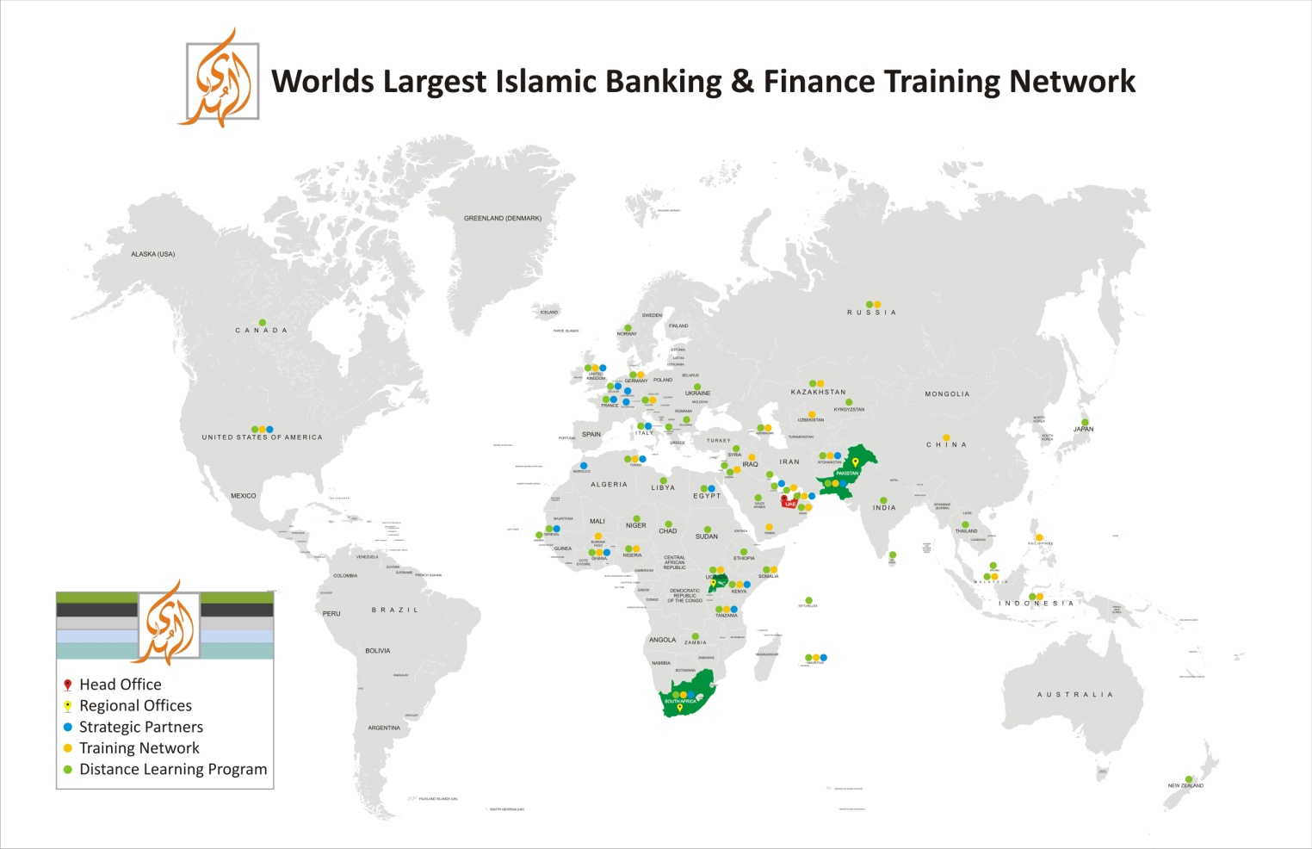

Slide 34
JazzakAllah Thank you for listening with patience
Muhammad Zubair Mughal
Chief Executive Officer
AlHuda Centre of Islamic Banking and Economics
Zubair.mughal@alhudacibe.com
www.alhudacibe.com

